Slide 1
Portfolio Optimization
Team 3 CSE 543 Final Project Presentation
Junhao Lan, Tommy Ahn, Hanqi Chen, Tillman James, Shane Canfield

Slide 2
Goals
Choose portfolio that maximizes returns and minimizes risk simultaneously
1. Using Mean Variance optimization
2. Modeling risk and maintain high portfolio returns
3. Covariance matrix construction and reduction
4. Comparing with S&P 500 (can we beat it)
Notes:
In this project we are working with the Mean Variance optimization framework to try appropriately model risk, while maintaining high portfolio returns
Trade off between the return and risk of investment
Goal:
Investigate different forms of covariance matrix construction and their performance
Try and beat the S&P500 using these different matrices and optimization framework

Slide 3
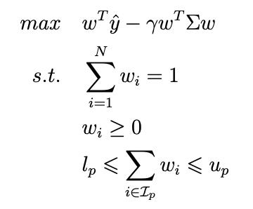
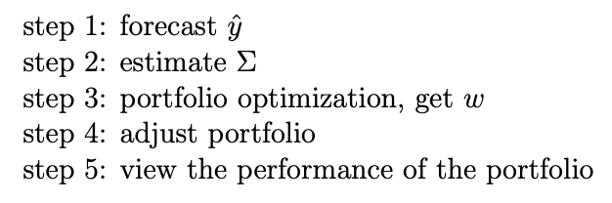
Optimization Problem and Motivation
Notes:
FOR JUNHAO

Slide 4
Data Collection: S&P500 Monthly Returns
We are fetching daily S&P 500 stock data from Alpha Vantage
Alpha Vantage is a free time series stock data API platform
Time series data such as simple moving average in a daily basis is saved with corresponding dates as CSV files
Daily stock data is converted into total monthly return for each stock in S&P 500
Monthly return values are the input to the model we have built
Notes:
FOR TOMMY

Slide 5
Covariance Matrix
Necessary to compute to incorporate risk of each stock within the portfolio into optimization problem
Problems:
Takes up a lot of space on GPU/CPU
Long computation time to construct
For a large number of stocks and not many observation days - it can be hard to compute
Computing the inverse of a large matrix is computationally inefficient (O(d^3))
Solution:
Make the matrix more sparse
brute force
PCA
Notes:
FOR TILLMAN

Slide 6
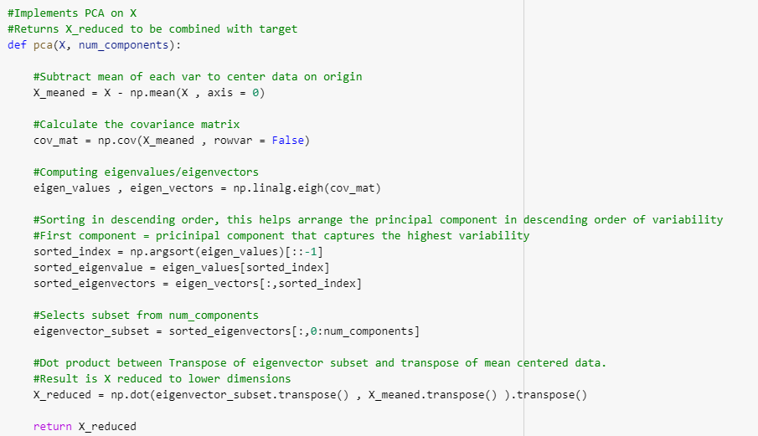
PCA and Covariance Matrix Reduction
NumPy covariance function.
Other methods to try:
Ledoit-Wolf
Exponential Covariance
Notes:
FOR SHANE
We with this principle components, we may decide to only keep as many as it takes to explain 95% of the variance, another way we can reduce the number of elements in our algorithms thus reducing computation costs and speed

Slide 7
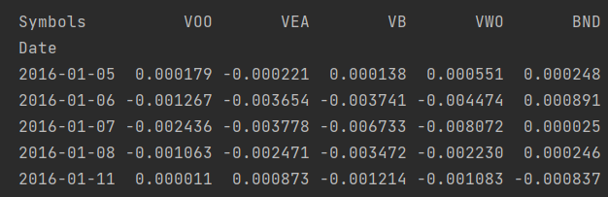
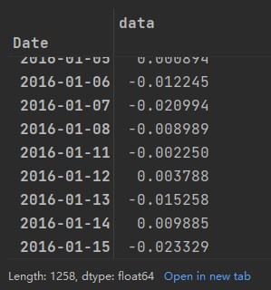
Portfolio Returns
Portfolio Returns of Aggregate Bonds ETF (BND) 10% Small Cap ETF (VB) 20% Developed markets ETF (VEA) 25%
S&P 500 ETF (VOO) 25% Emerging Markets ETF (VWO) 20% from 2016-2020
Notes:
My part is to calculate the returning from buying different stocks over a period of time by using the weights obtained based on Junhao’s work, here is an example of buying stocks of only five companies.
The table on the right shows the daily returns of these five companies from 2016 to 2020, and after multiplying each by the corresponding weight and summing them, that is the daily return of buying the stock according to our model.

Slide 8
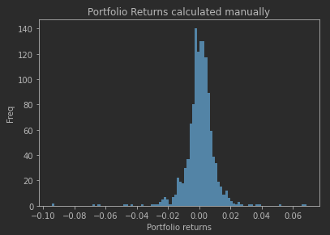
Portfolio Returns
Portfolio Returns of Aggregate Bonds ETF (BND) 10% Small Cap ETF (VB) 20% Developed markets ETF (VEA) 25%
S&P 500 ETF (VOO) 25% Emerging Markets ETF (VWO) 20% from 2016-2020
Notes:
This is a graph of the return frequency. The higher blue column in the positive portfolio means more returns we got.

Slide 9
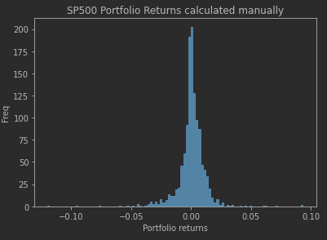
Returns Comparison
Notes:
Now, we got the graph of return frequency of SP500, and Portfolio returns got based on our optimization method. We need to calculate the difference between them and merge these two graphs.

Slide 10
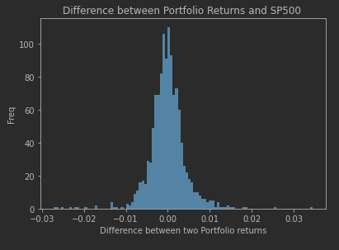
Returns Comparison
Notes:
This is the merge graph we got, it shows the difference, the higher blue column in positive number means our optimization method more better than SP500.

